Slide 1
Web fundamentals project

Slide 2
How does the web work
When you enter something like Google.com the request goes to one of many special computers on the Internet known as Domain Name Servers (DNS). All these requests are routed through various routers and switches. The domain name servers keep tables of machine names and their IP addresses, so when you type in Google.com it gets translated into a number, which identifies the computers that serve the Google Website to you.
When you want to view any page on the Web, you must initiate the activity by requesting a page using your browser. The browser asks a domain name server to translate the domain name you requested into an IP address. The browser then sends a request to that server for the page you want, using a standard called Hypertext Transfer Protocol or HTTP.

Slide 3
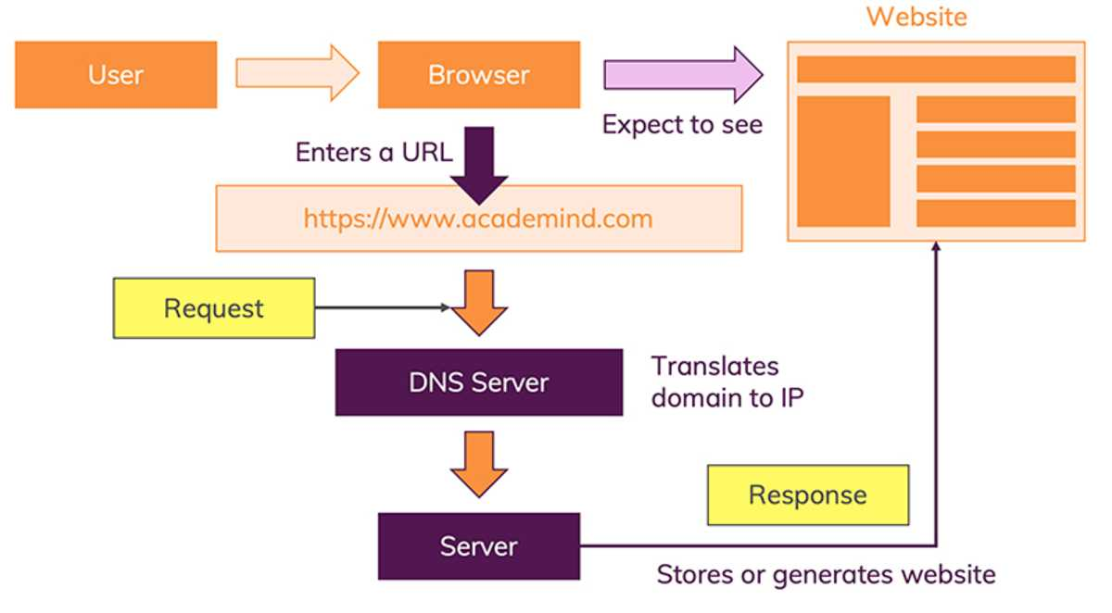
How does the web work

Slide 4
What do you need to be a web developer
There is tree type of web developer
Front-end developer : are responsible for the parts of a website that people see and interact with,
back-end developers : are responsible for the behind the scenes code that controls how a website loads and runs
full-stack developers do a bit of everything.

Slide 5
What do you need to be a web developer
Learn the Basics of HTML, CSS, and Javascript
These are the nuts and bolts of all website development that you’ll work with daily if you decide to build websites for a living.
HTML dictates the structure.
CSS will make it look pretty.
JavaScript will make it function.

Slide 6
Why did I choose to learn web development?
The reasons to learn web development are plentiful, but in short: Learning web development teaches critical thinking skills, communication skills, and opens the door to lucrative job opportunities.
You Can Work From Anywhere
There Are Always Freelance Opportunities
It’s Creative and Fun

